Slide 1
Search
1

Slide 2
Introduction
2
Simple-reflex agents directly maps states to actions.
Therefore, they cannot operate well in environments where the mapping is too large to store or takes too much to learn
Goal-based agents can succeed by considering future actions and desirability of their outcomes
Problem solving agent is a goal-based agent that decides what to do by finding sequences of actions that lead to desirable states

Slide 3
Outline
3
Problem-solving agents
Problem types
Problem formulation
Example problems
Basic search algorithms

Slide 4
Problem solving agents
4
Intelligent agents are performance measure
supposed to maximize their
This can be simplified if the agent can adopt a goal and aim at satisfying it
Goals help organize behaviour by limiting the objectives that the agent is trying to achieve
Goal formulation, based on the current situation and the agent’s performance measure, is the first step in problem solving
Goal is a set of states. The agent’s task is to find out which sequence of actions will get it to a goal state
Problem formulation is the process of deciding what sorts of actions and states to consider, given a goal

Slide 5
Problem solving agents
5
An agent with several immediate options of unknown value can decide what to do by first examining different possible sequences of actions that lead to states of known value, and then choosing the best sequence
Looking for such a sequence is called search
A search algorithm takes a problem as input and returns a solution in the form of action sequence
One a solution is found the actions it recommends can be carried out – execution phase

Slide 6
Problem solving agents
6
“formulate, search, execute” design for the agent
After formulating a goal and a problem to solve the agent calls a search procedure to solve it
It then uses the solution to guide its actions, doing whatever the solution recommends as the next thing to do (typically the first action in the sequence)
Then removing that step from the sequence
Once the solution has been executed, the agent will formulate a new goal

Slide 7
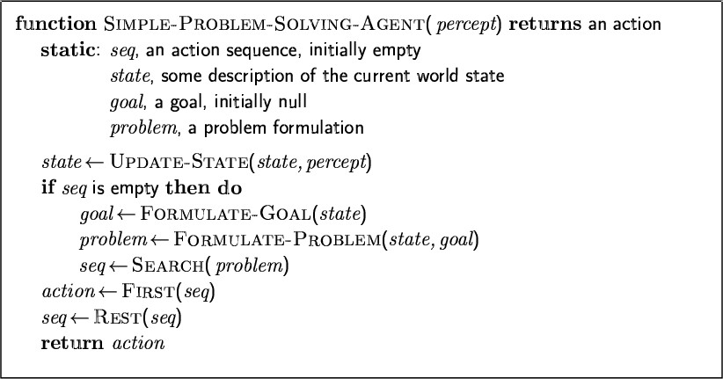
Problem-solving agents
7

Slide 8
Environment Assumptions
8
Static, formulating and solving the problem is done without paying attention to any changes that might be occurring in the environment
Initial state is known and the environment is observable
Discrete, enumerate alternative courses of actions
Deterministic, solutions to problems are single sequences of actions, so they cannot handle any unexpected events, and solutions are executed without paying attention to the percepts

Slide 9
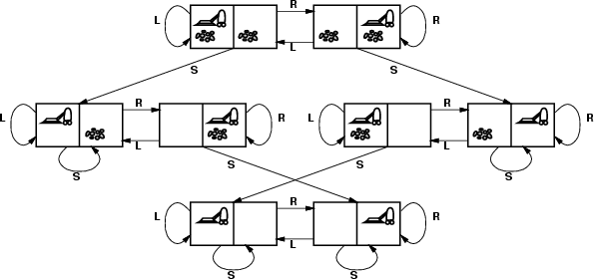
Vacuum world state space graph
13
states integer dirt and robot location.
– The agent is in one of two locations, each of which might or might not
contain dirt – 8 possible states
Initial state: any state
actions Left, Right, Suck
goal test no dirt at all locations
path cost 1 per action

Slide 10
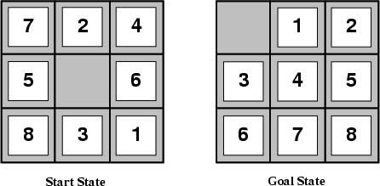
Example: The 8-puzzle
14
states: locations of tiles
Initial state: any state
actions: move blank left, right, up, down
goal test: goal state (given)
path cost: 1 per move

Slide 11
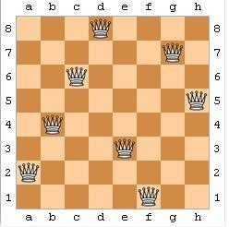
Example: 8-queens problem
15
states: any arrangement of 0-8 queens on the board is a state
Initial state: no queens on the board
actions: add a queen to any empty square
goal test: 8 queens are on the board, none attacked
64.63...57 = 1.8x10¹⁴ possible sequences

Slide 12
Example: Route finding problem
16
states: each is represented by a location (e.g. An airport) and the current time
Initial state: specified by the problem
Successor function: returns the states resulting from taking any scheduled flight, leaving later than the current time plus the within airport transit time, from the current airport to another
goal test: are we at the destination by some pre-specified time
Path cost:monetary cost, waiting time, flight time, customs and immigration procedures, seat quality, time of day, type of airplane, frequent-flyer mileage awards, etc
Route finding algorithms are used in a variety of applications, such as routing in computer networks, military operations planning, airline travel planning systems

Slide 13
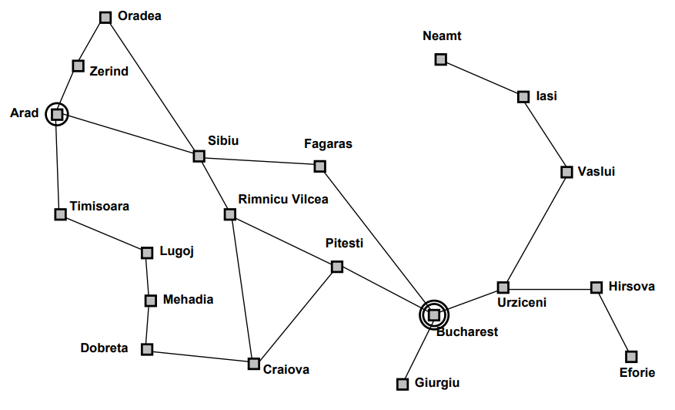
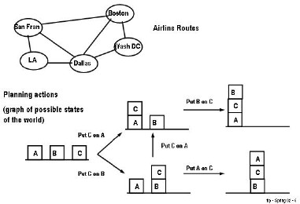
Graphs
19

Slide 14
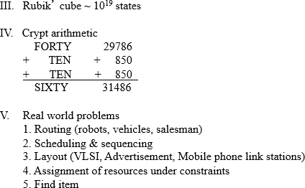
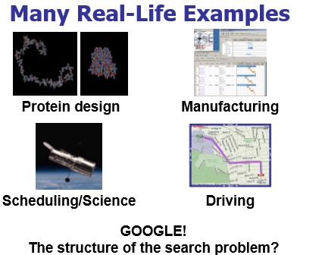
20

Slide 15
General problem:
Find a path from a start state to a goal state given:
A goal test: Tests if a given state is a goal state
A successor function (transition model): Given a state, generates its successor states
Variants:
Find any path vs. a least-cost path
Goal is completely specified, task is just to find the path
Route planning
Path doesn’t matter, only finding the goal state
8 puzzle, N queens, Rubik’s cube
6

Slide 16
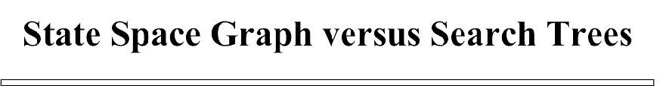









State Space Graph
(graph of states with arrows pointing to successors)
a
G
b
c
e
d
f
S
h
p
q
r

Slide 17
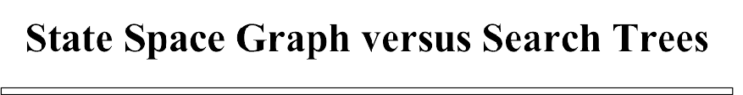








a
G
b
c
d
e
h
S
f
p
q
r
S
d
b c
a a ^{h r}
q f
c
a
e
p q
h r
q f
c
a
Search Tree
e
G
G

Slide 18
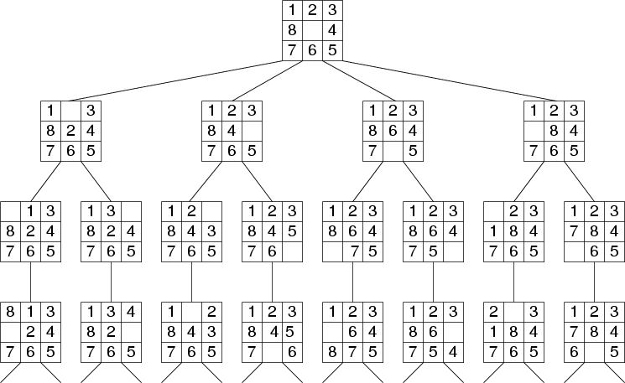
11

Slide 19
Evaluating Search Strategies
Completeness
Guarantees finding a solution whenever one exists
Time Complexity
How long (worst or average case) does it take to find a solution? Usually measured in terms of the number of nodes expanded
Space Complexity
How much space is used by the algorithm? Usually measured in terms of the maximum size that the “OPEN" list becomes during the search
Optimality/Admissibility
If a solution is found, is it guaranteed to be an optimal one? For example, is it the one with minimum cost?

Slide 20
8-PUZZLE PROBLEM SOLVING
1 | 2
4 | 5 | 3
7 | 8 | 6
Input:
Branching factor, b=2
1 |  | 2
4 | 5 | 3
7 | 8 | 6
1 | 2 | 3
4 | 5
7 | 8 | 6
b=3
b=3
1, R
2, L
5, U
3, D
5, R
6, U
1 | 2 | 3
4 | 5 | 6
7 | 8
Goal

Slide 21
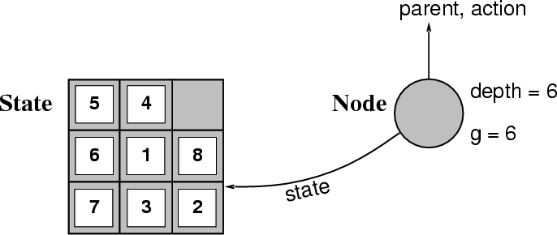
Implementation: states vs. nodes
30
A state is a (representation of) a physical configuration
A node is a data structure constituting part of a search tree includes
state, parent node, action, path cost g(x), depth

Slide 22
Implementation: Components of a node
29
State: the state in the state space to which the node corresponds
Parent-node: the node in the search tree that generated this node
Action: the action that was applied to the parent to generate the node
Path-cost: the cost, traditionally denoted by g(n), of the path from the initial state to the node, as indicated by the parent pointers
Depth: the number of steps along the path from the initial state

Slide 23
31
Implementation: general tree search
Fringe: the collection of nodes that have been generated but not yet been expanded
Each element of a fringe is a leaf node, a node with no successors
Search strategy: a function that selects the next node to be expanded from fringe
We assume that the collection of nodes is implemented as a queue
The operations on the queue are:
Make-queue(queue)
Empty?(queue)
first(queue)
remove-first(queue)
insert(element, queue)
insert-all(elements, queue)

Slide 24
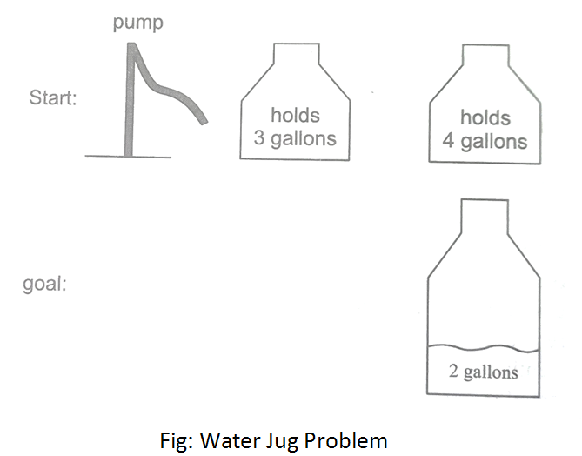
Examples: water jug problem
34
Consider the following problem: A Water Jug Problem: You are given two jugs, a 4-gallon one and a 3-gallon one, a pump which has unlimited water which you can use to fill the jug, and the ground on which water may be poured. Neither jug has any measuring markings on it. How can you get exactly 2 gallons of water in the 4-gallon jug?

Slide 25
Examples: water jug problem
34
we will represent a state of the problem as a tuple (x, y) where x represents the amount of water in the 4-gallon jug and y represents the amount of water in the 3-gallon jug. Note 0 ≤ x ≤ 4, and 0 ≤ y ≤ 3. Our initial state: (0,0) Goal Predicate – state = (2,y) where 0 ≤ y ≤ 3.

Slide 26
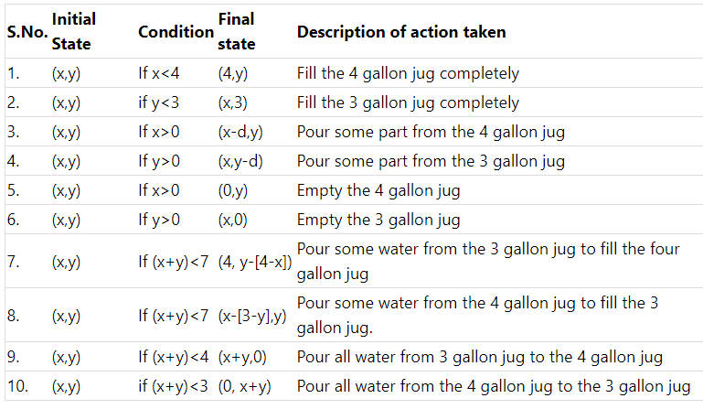

Slide 27
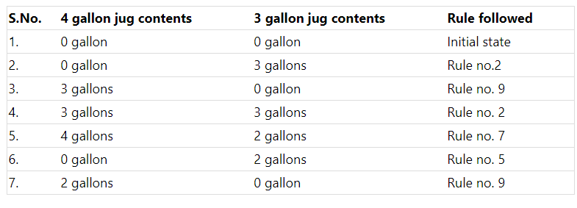

Slide 28
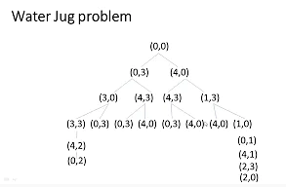

Slide 29
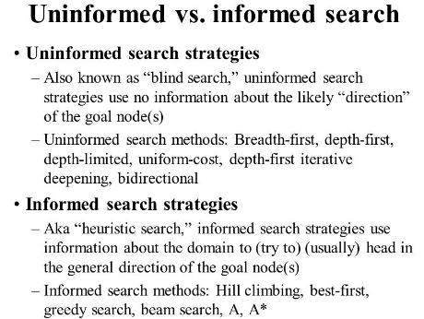

Slide 30
